Slide 1
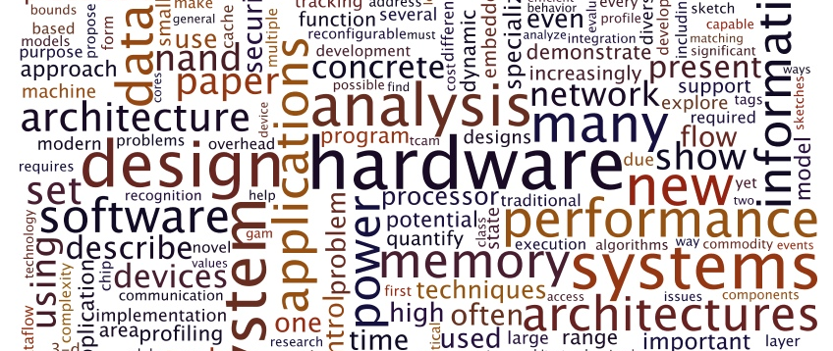
Concepts I wished I learned earlier on
by Alex Joslin

Slide 2
Computer Science Fields
Data Science / Data Analysis
AI / ML / DL / NLP
Web
Cloud Computing
Bioinformatics
Game Design
Networking
Mobil Development
Cyber Security
Systems Engineering
IOT
DevOps
Big Data
Embedded
Software Testing

Slide 3
Computer Science Fields
Data Science / Data Analysis
AI / ML / DL / NLP
Web
Cloud Computing
Bioinformatics
Game Design
Networking
Mobil Development
Cyber Security
Systems Engineering
IOT
Big Data
Embedded
Software Testing

Slide 4

The fundamentals

Slide 5
General Concepts
Procedural Programming
Object-Oriented Program
The call stack (memory allocation)
The heap (memory allocation)
Compilers & Interpreters
Static vs Dynamically typed languages
Understanding what different languages are used for

Slide 6
Data Structures and Algorithms
Stacks
Queues
Linked Lists
Binary Trees
Graphs
Recursion / Dynamic Programming
DFS
BFS
Sorting Algorithms

Slide 7
Other
Design Patterns (pub/sub, singleton, adapter, facade, state machines)
Software Architectures (MVC, Client-Server, sense-computer-control, pipe-and-filter)

Slide 8

Git
Git is a version control system
Every software company uses it
It is impossible to escape it during your programming career
Master it as soon as possible

Slide 9

Linux
Linux is an operating system.
Virtually every software company uses it to some extent for development.
Learn it as soon as possible

Slide 10

Web

Slide 11

Frameworks
Frontend (React, Angular, Vue)
Backend (Spring Boot, Django, ASP.NET, Express, Laravel)

Slide 12
REST APIs
REST = REpresentational State Transfer
API = Application Programmable Interface
A standardized way for servers an clients to communicate with each other over a network through a collection of http requests.
OpenAPI Specification Course Example
Request Endpoints Description
GET /courses <- Get all courses
POST /courses <- Add a new course
GET /courses/{ID} <- Get a specific course
PUT /courses/{ID} <- Update a specific course
DELETE /courses/{ID} <- Delete a specific course
GET /courses/{ID}/students <- Get students belonging to a course
POST /courses/{ID}/students <- Add a student to a course

Slide 13

Microservices
It is an architecture style that structures an application as a collection of independent services that communicate with one another.

Slide 14

Example: Amazon.com

Slide 15
Monolithic Architecture
Monolithic
User Authentication
One repository containing entire app.
Written in 1 language / 1 tech stack.
Everything is developed, scaled, and deployed as a single unit.
Payment
Notifications
Teams need to be careful not to affect other people’s work.
One artifact so must deploy the entire app for each update.
Testing is much more complex because of dependencies.
Scaling must be done on entire app and can’t do individual services.
Shopping Cart
Suggestion Engine
Returns & Orders

Slide 16
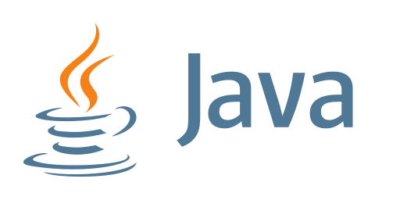

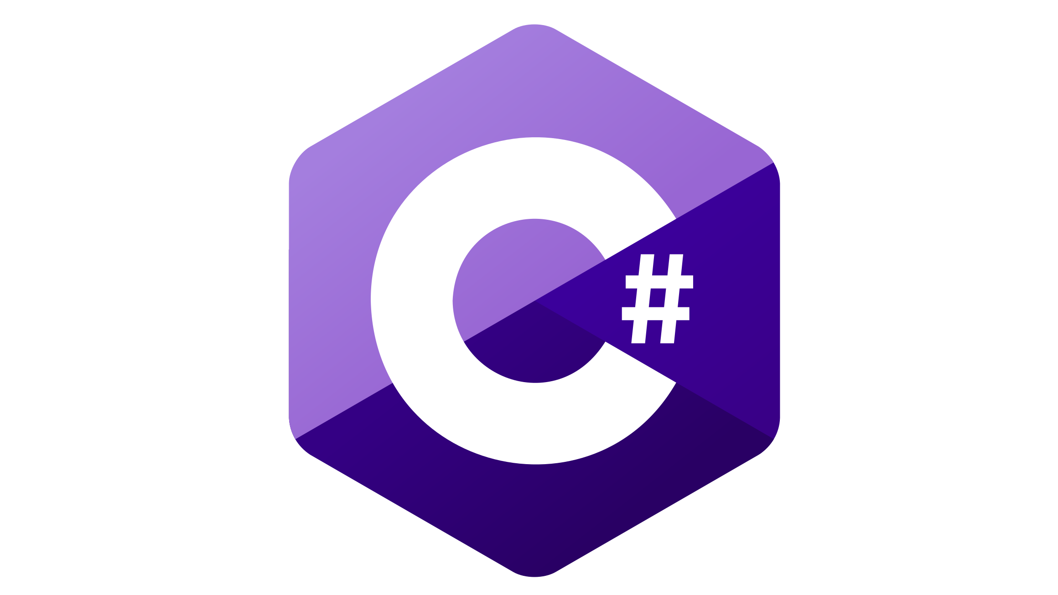
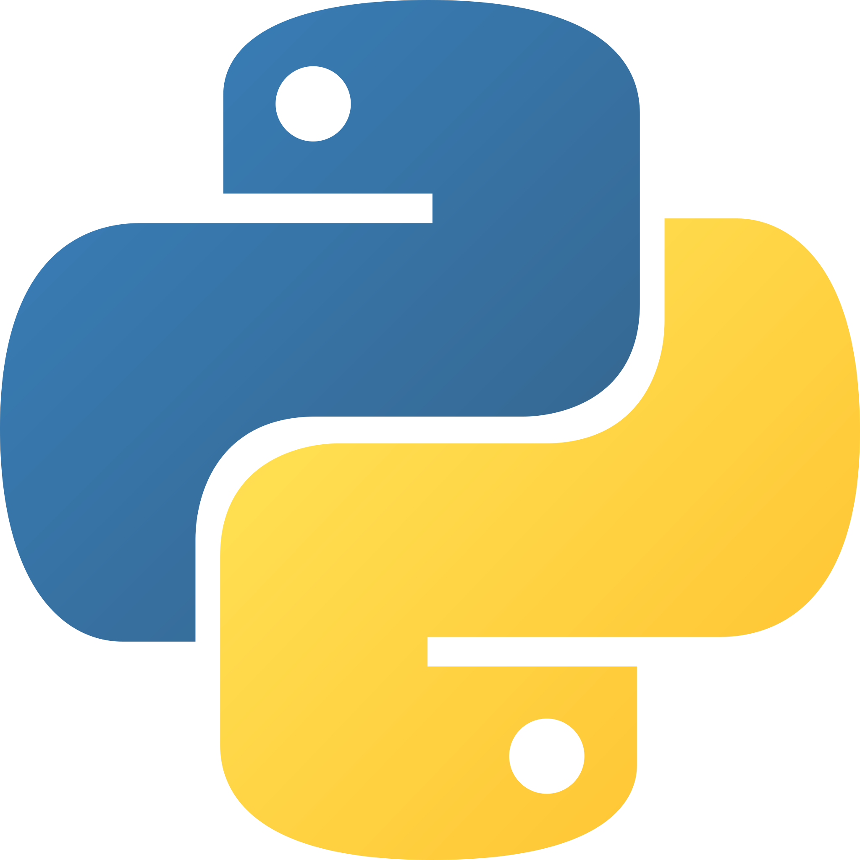
Microservices Architecture
User Authentication
api
Each service can be in different repositories.
Can implement each service in any programming language.
Can scale certain services.
Each microservice does one specific job
Each service is developed, scaled, and deployed separately.
Services interact with each other through APIs
Payment
Notifications
api
api
api
Complexities of a distributed system.
Difficult to manage the entire system as a whole.
Communication between different services can be complex.
Global testing is difficult.
Can be slower to implement.
Shopping Cart
Suggestion Engine
api
Returns & Orders

Slide 17
Top 5 things to learn (Summary)
Git
Linux
APIs
Microservices
Protocols

